Slide 1



Reverse Engineering
of Rocket-Chip
December 8-10 | Virtual Event

Slide 2
December 8-10 | Virtual Event
Reverse Engineering of Rocket-Chip
Dr. Roomi Naqvi
Director
MERL-PAKISTAN
#RISCVSUMMIT

Slide 3
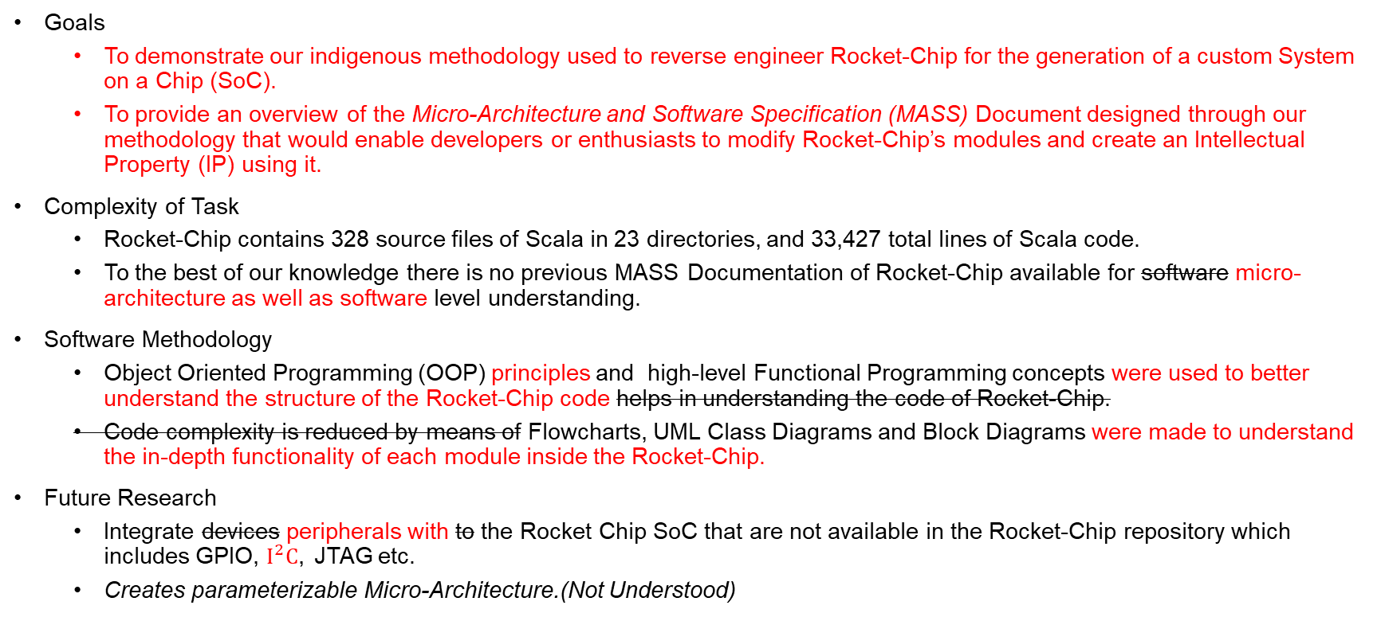
To Be Covered
Goals
To demonstrate our indigenous methodology used to reverse engineer Rocket-Chip for the generation of a custom System on a Chip (SoC).
To provide an overview of the Micro-Architecture and Software Specification (MASS) Document designed through our methodology that would enable developers or enthusiasts to modify Rocket-Chip’s modules and create an Intellectual Property (IP) using it.
Complexity of Task
Rocket-Chip contains 328 source files of Scala in 23 directories, and 33,427 total lines of Scala code.
To the best of our knowledge there is no previous MASS Documentation of Rocket-Chip available for software micro-architecture as well as software level understanding.
Software Methodology
Object Oriented Programming (OOP) principles and high-level Functional Programming concepts were used to better understand the structure of the Rocket-Chip code helps in understanding the code of Rocket-Chip.
Code complexity is reduced by means of Flowcharts, UML Class Diagrams and Block Diagrams were made to understand the in-depth functionality of each module inside the Rocket-Chip.
Future Research
Integrate devices peripherals with to the Rocket Chip SoC that are not available in the Rocket-Chip repository which includes GPIO, $I^{2}C$, JTAG etc.
Creates parameterizable Micro-Architecture.(Not Understood)

Slide 4
Motivation and Scope
To provide a detailed elaboration and establish an understanding of Rocket-core and use Rocket-Chip to generate a customized System on Chip (SoC). Moreover, to modify and enhance a module based on customized specifications later.
To provide a hardware insight by mapping it to blocks of code which highlights the wiring and back tracing of input/output by means of variables. Hardware mapping provides a connection in the entire workflow between software and hardware.
The Microarchitecture Specification (MAS) Document developed by MERL-UIT aims to present a detailed description of Rocket-Chip Core and its micro-architecture with additional representations such as block diagrams and flowcharts.

Slide 5
Methodology
Decoded basic modules of Rocket-Core by understanding its code with the help of Scala and Chisel expertise.
Represented the code flow through flow charts, class diagram and block diagrams.
These diagrams and understandings were then ported into the Micro Architecture Specification MASS document.
Used the MASS Document together with Rocket-Chip generator to generate Aghaaz (آغاز) SoC

Slide 6
Hardware Insight of Rocket-Chip

Slide 7
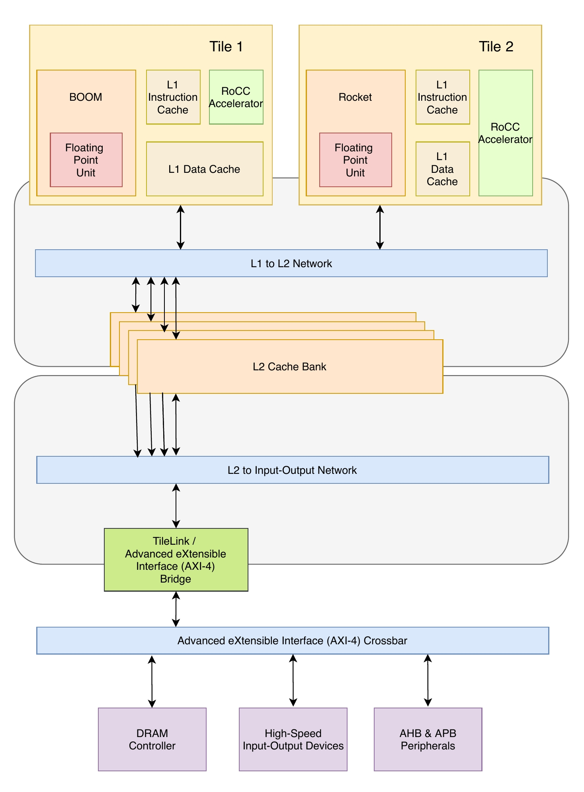
Rocket-Chip Overview
Rocket-Chip is an SoC generator framework and can be configured with single or multiple processor cores, caches, on-chip busses, individual buses and bus interconnections. All these devices are a part of SoC which is referred as a sub system.
A full chip however needs some additional devices which include (UART, GPIO etc.) that have not been accommodated in the Rocket-Chip repository which can be viewed at sifive/sifive-blocks.
To add these modules we have to understand the diplomacy of Rocket-Chip. Diplomacy is a Scala run-time parameter negotiation and generation mechanism. It is implemented in Chisel language and heavily leverages the software engineering features provided by Chisel (Scala).
Rocket-Chip uses the power of a domain specific language Chisel constructed in Scala. Chisel provides a strong mechanism for generating parameterizable digital hardware circuits that are reusable and optimized for FPGAs as well as ASIC.
Chisel generated circuits are then transformed into an intermediate representation through Firrtl. This representation is then further transformed by the Firrtl into Verilog.

Slide 8
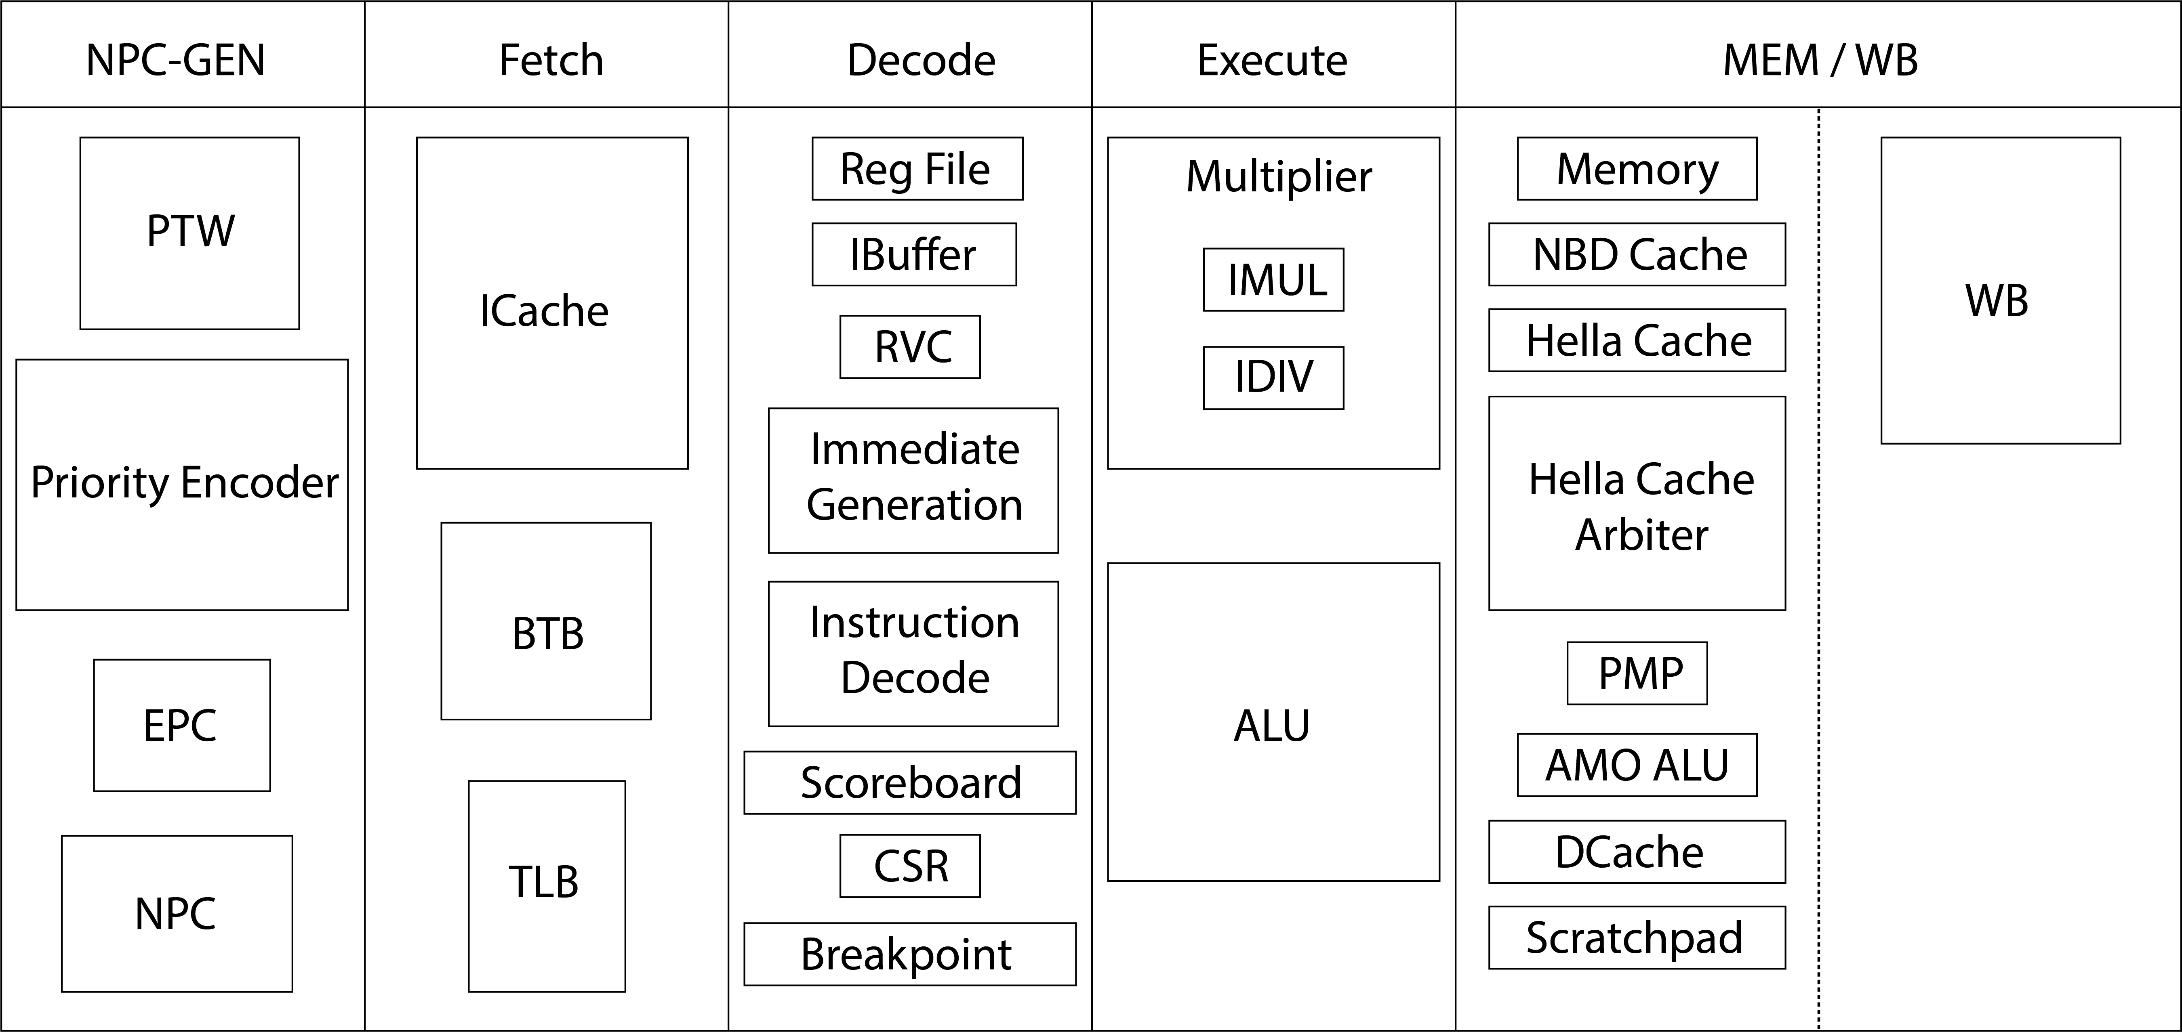
Rocket-Chip Micro-Architecture

Slide 9
Rocket-Chip Modules Description
NPC-Gen Modules Description
Module | Description
PTW | Page table is used to access the virtual memory. nL2TLBEntries parameter is used by Rocket-Chip PTW for controlling TLB entries.
Priority Encoder | Priority Encoder take all of the data inputs one at a time and converts them into an equivalent binary code at its output. Rocket-Chip Priority Encoder is taking takes pins as inputs from BTB and EPC (from all stages) to select the value of NPC.
EPC | The Exception Program Counter (EPC) is used to store the address of the instruction that was executing when the exception was generated. The size of the EPC register depends upon the width XLen of the ISA which can be of either [31:0] or [63:0].
NPC | New Program Counter (NPC) is used to increment +4 in current PC and store it in a register. The size of the NPC register depends upon the width of the ISA XLen which can be either [31:0] or [63:0].
Fetch Modules Description
Module | Description
ICache | The Instruction Cache acts as a buffer memory between external memory and the core processor. In Rocket-Chip size of the ICache sets, ways and block can be configured from the Config.scala file in subsystem directory of Scala files. Size of ICache is calculated by: nWays x nSets x blockBytes
BTB | Branch Target Buffer (BTB) is a cache-like component in processors that is used for branch prediction. The main concept of the BTB is to store the program counter (PC) of a branch instruction, and the PC of the target of the branch. The bit size of branch prediction is [1:0].
TLB | Translation Lookaside Buffer (TLB) is a memory cache which is used to keep track of recently used transactions and reduce the time taken to access a user memory location’s. It is connected with Rocket-Chip PTW and work as cache for PTW. TLB entries is controlled by PTW of Rocket-Chip.

Slide 10
Decode Modules Description
Module | Description
Register File | Registers are temporary storage locations that hold data and addresses. The width of the rocket-Chip file register is fixed by the XLen parameter either [31:0] or [63:0].
Instruction buffer | Ibuffer is a temporary register where the opcode of the currently fetched instruction from instruction memory is stored. The RV32 or RV64 instruction opcode is [6:0] bits. The Ibuffer size is set for ISA 32 and 64.
RVC | This Module holds RISC-V Compressed (C-Extension) Instructions. To use the RISC-V Compressed instructions, useCompressed [Bool], which is present in Rocket-Chip config file, should be true.
Immediate Generation | Immediate generation module generates immediate for instructions of RISC-V. This module is located in RocketCore.scala and returns immediate bits depending upon the size of ISA [31:0] or [63:0].
Instruction Decode | This module decodes instructions for RISC-V which come from Instruction Memory. Width of the instruction can be parameterizable depending upon the ISA width RISC-V[31:0].
Scoreboard | Scoreboards are designed to control the flow of data between registers and multiple arithmetic units in the presence of conflicts caused by hardware resource limitations (structural hazards) and by dependencies between instructions (data hazards).Scoreboard module lies in RocketCore.scala.
CSR | Control and Status Register (CSR) module contains control registers to enable and handle different interrupts and exceptions timer a register in many central processing units that are used as storage devices for information about instructions received from machines.The width of the CSRs is parameterizable either [31:0] or [63:0] depending on the ISA width.
Breakpoint | A breakpoint is a location in executable code at which the operating system stops execution and breaks into the debugger. This allows you to analyze the target and issue debugger commands.

Slide 11
Execute Modules Description
Module | Description
Multiplier | This module is present inside the Rocket-Core execute stage and is used to perform M-Type Instructions. Multiplier operation is parameterizable and depends upon the XLen width (Width of the operands of Multiplier). XLen either [31:0] or [63:0].
ALU | An arithmetic logic unit (ALU) is a digital circuit used to perform arithmetic and logic operations in Rocket-Core. ALU operands is parameterizable depends upon the XLen width (Width of the operands of ALU). XLen either [31:0] or [63:0].
Memory/ Write-Back Modules Description
Module | Description
Memory | This module is for accessing data from Rocket-Core memory with the use of load instructions
HellaCache | HellaCache is the acronym of Level 1 Data cache in Rocket-Chip. L1 Dcache directly built into the microprocessor, which is used for storing the microprocessor's recently accessed information, thus it is also called the primary cache. The size of the cache depends upon the width of the ISA.
HellaCache Arbiter | This module is for accessing L1 Dcache (HellaCache), by means of requests generated from other modules for read and write operations.
PMP | Physical Memory Protection (PMP) is a part of the RISC-V Privileged Architecture Specification which describes the interface for a standard RISC-V memory protection unit. The PMP defines a finite number of PMP regions which can be individually configured to enforce access permissions to a range of addresses in memory
AMO-ALU | This module is used to perform the A Extension RISCV operations. To use the Rocket-Core Atomic ALU module, useAtmoics [Bool],which is in the rocket-Chip config file, should be true.
Dcache | This Module is used to hold the data for temporary period of time.Size of the Dcache sets, ways and block can be configured from the Config.scala file in subsystem directory of Scala files. Size of DCache is calculated by: nWays x nSets x blockBytes.
Scratchpad | (SPRAM) is a high-speed internal memory directly connected to the CPU core and used for temporary storage to hold very small items of data for rapid retrieval. To add the scratchpad in our SoC we need to call the scratchpad class in our config file which lies in system directory of Scala.
WB | This module performs the Write back operation in the Rocket-Core. This module will write the data into the Rocket-Core memory or register file of Rocket-Core. The writeback stage of Rocket-Core is defined in Rocketcore.scala file

Slide 12
Software Insight of Rocket-Chip

Slide 13
Code Complexity
The complexity of code of Rocket-chip is high, because it contains 372 files in 73 directories, after the submodules the numbers increase to 151,613 files in 8,625 directories and after running the build script to generate an SoC the numbers grow to 185,049 files in 10,780 directories¹.
The code of Rocket-chip is extensive and complex because it contains 328 source files of Scala in 23 directories, and 33,427 total lines of Scala code. As mentioned before in “to be covered” slide.
Another problem faced was that Rocket-Chip includes many irrelevant variable names and non elaborated statements, further contributing to process increasing the confusion, raising the decoding complexity and making it difficult to understand the inputs / outputs of the hardware.
Lack of understandability and comprehension concludes to difficulty in modifying Rocket-core or its component as for customized requirements.
¹ Durrum, J., Bryant, A. and Porter, J., 2019. Reverse Engineering RISC-V Generator-Based Designs for Trust and Assurance. AFRL/RYDT WPAFB United States.

Slide 14
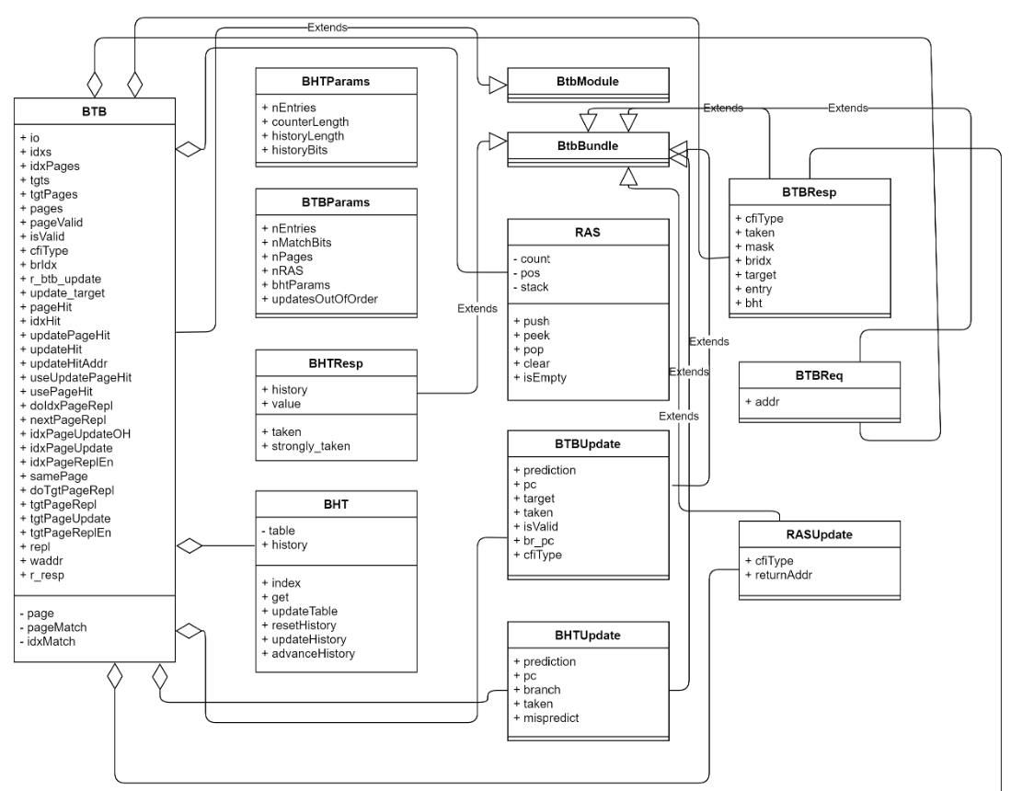
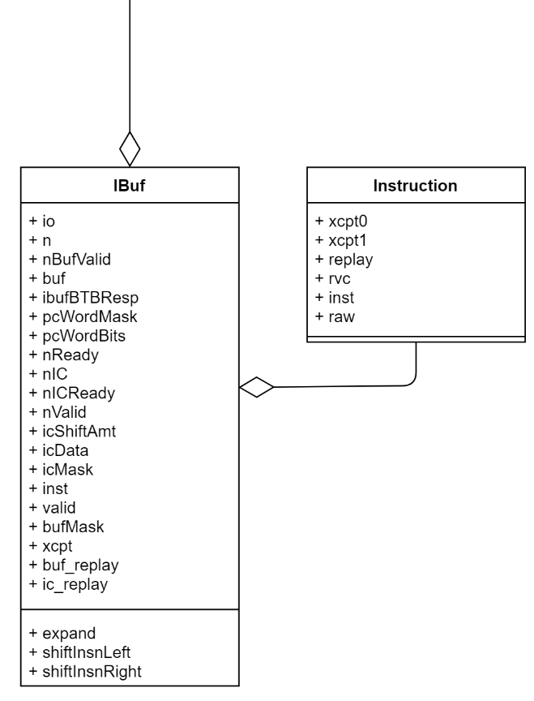
Code Hierarchy
Instruction Buffer
Branch Target Buffer (BTB)

Slide 15
Class Diagram Explanation
Class IBuf has an instance of BTBResp initialized by the variable ibufBTBResp
Class name BTBResp
Class name IBuf
Public Attributes of class BTBResp
Public Methods of class BTBResp
Public Attributes of class IBuf
Class BTBResp is inherited from its parent class (BtbBundle), therefore it uses the methods of its parent class.

Slide 16
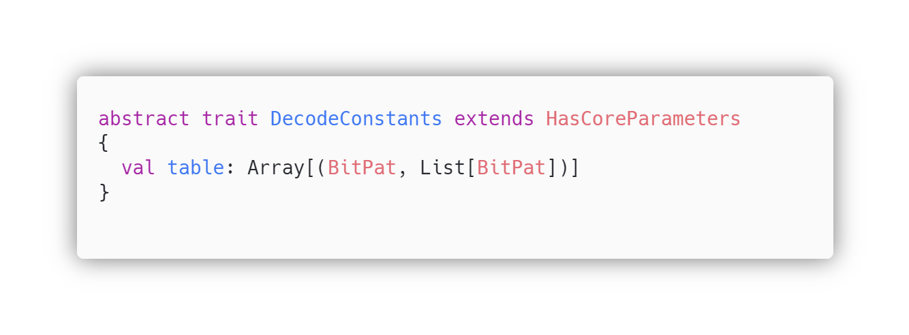
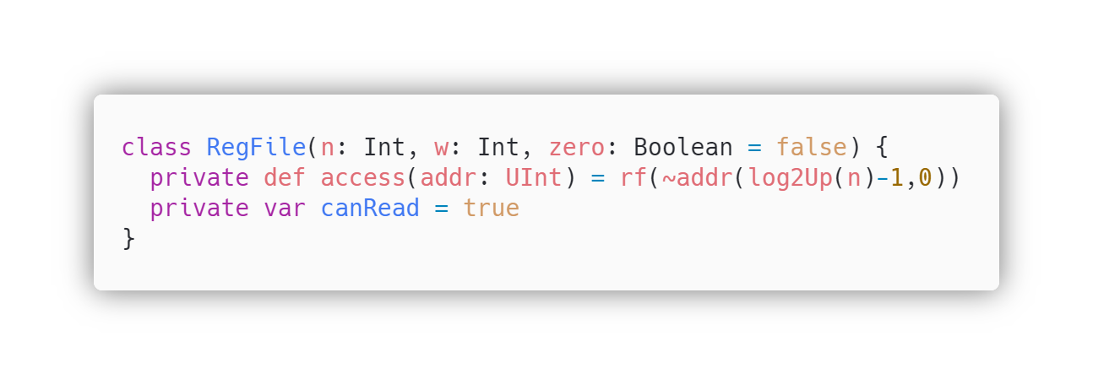
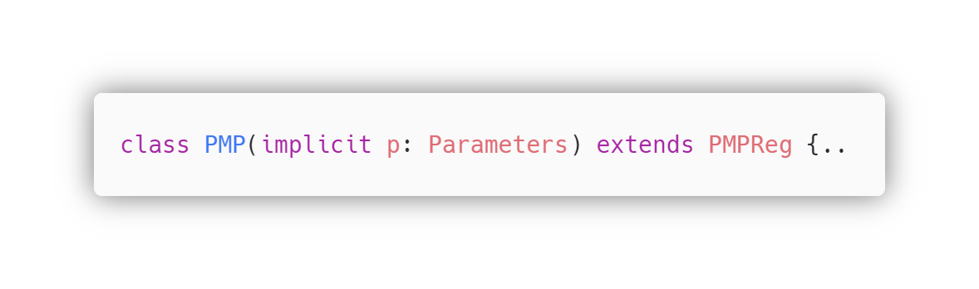
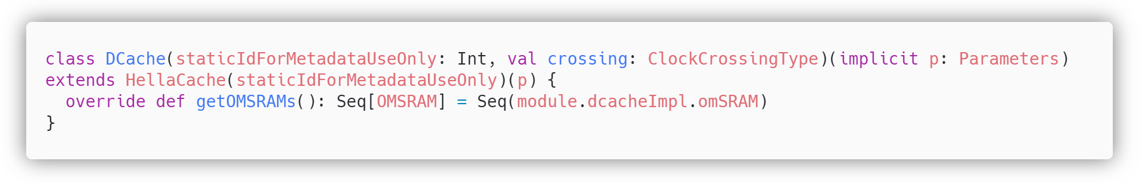
Object Oriented Code of Rocket-Chip
Abstraction
Abstraction is achieved by abstract keyword, creating an abstract trait of DecodeConstants.
Encapsulation
Private access modifier is used to encapsulate/hide method ‘access’ from other extended classes.
Inheritance
Keyword extend is used to extend/inherit the PMP class with parent class PMPReg.
Polymorphism
Keyword override is used to override method getOMSRAMs, which is already defined in the parent class.

Slide 17
Putting it all Together (MASS: Hardware and Software)

Slide 18
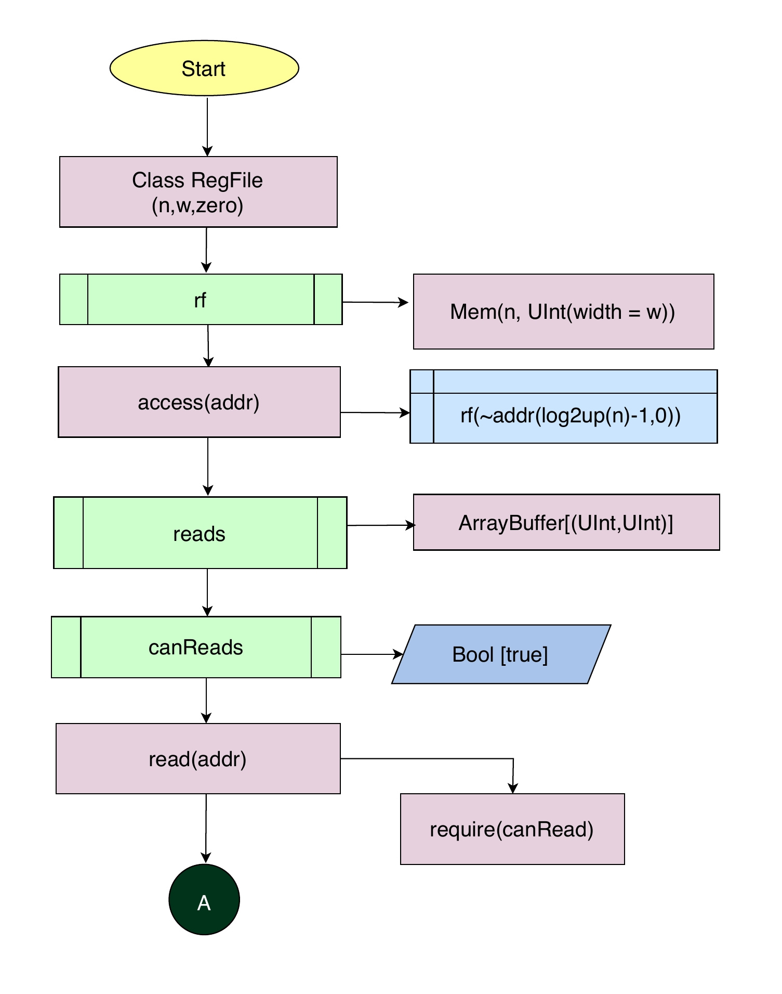
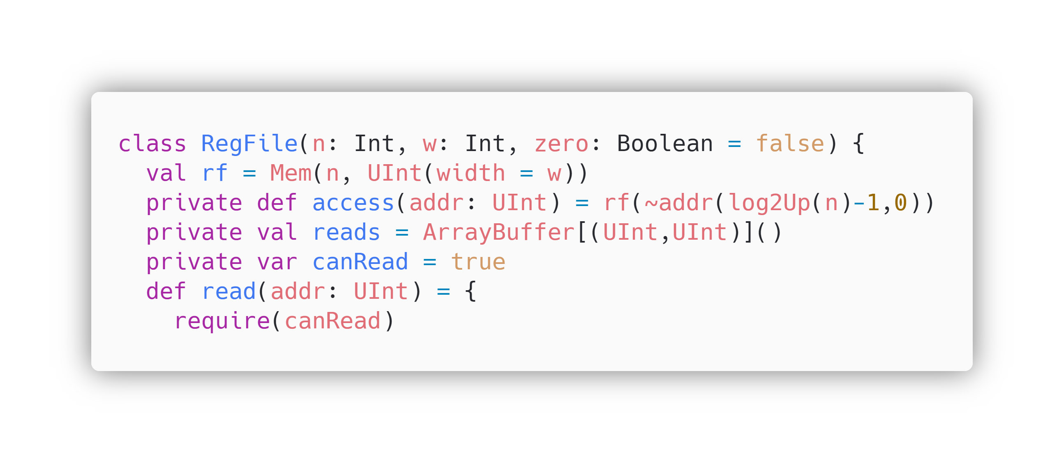
Code Explanation and Back-tracing
by Flowcharts and Block Diagram
Class RegFile is initiated with three parameters n, w and zero having type Int and Bool, where n and w are passed in Mem function to configure the depth and width of memory. zero is the input parameter used in MUX for reading data from the register.
This class creates register file of rocket-Chip.
Mem function is used to create memory where n= depth/entries of memory and w=width of memory.
In the class RegFile, a private method named access is defined for accessing the register file data by taking the address as its input parameter.
Private variable reads calculates the address which will be used to read the data.
Private variable canRead is defined as true for read state.
For write state canRead will be false.
“read” method is defined in class RegFile to read data from register file. It takes addr as parameter.

Slide 19
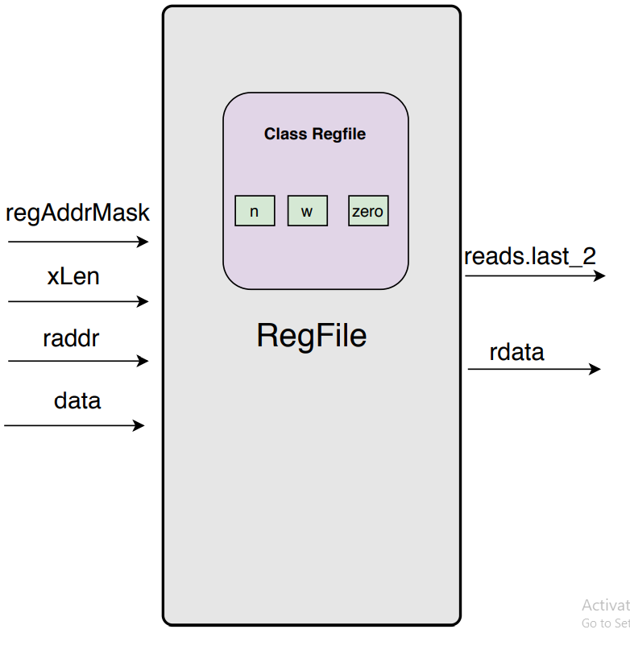
regAddrMask [n] = depth/entry of register file memory
reads.lasts._2 = data read from register file address [31:0] / [63:0]
XLen[w] = width of registers [31:0] / [63:0]
raddr = address of register [4:0]
data = data to be written in the register [31:0] / [63:0]
rdata = data output from register file [31:0] / [63:0]

Slide 20
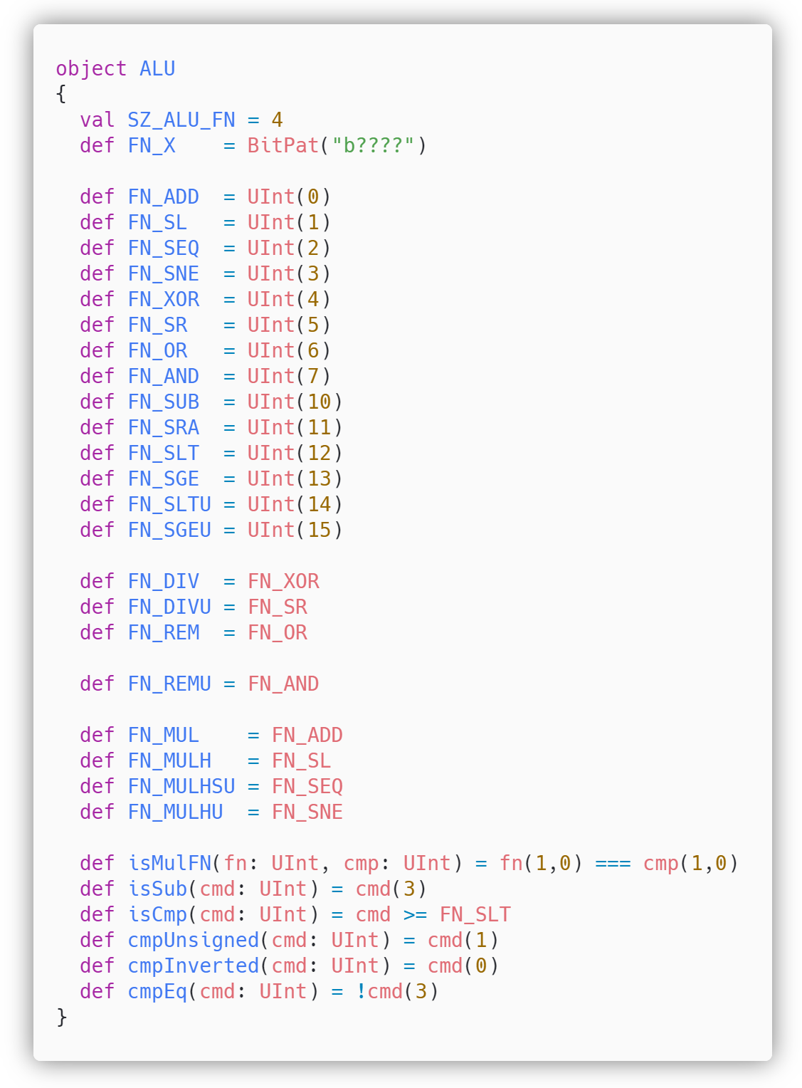
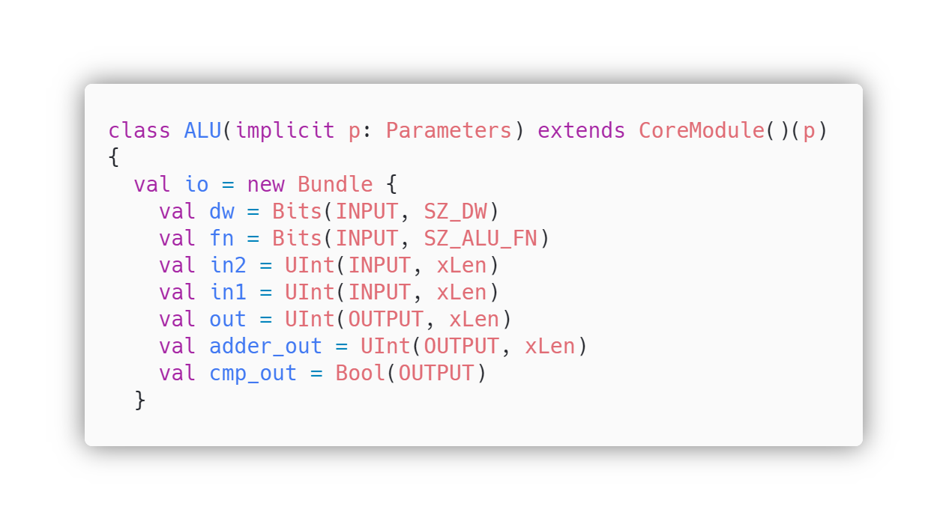
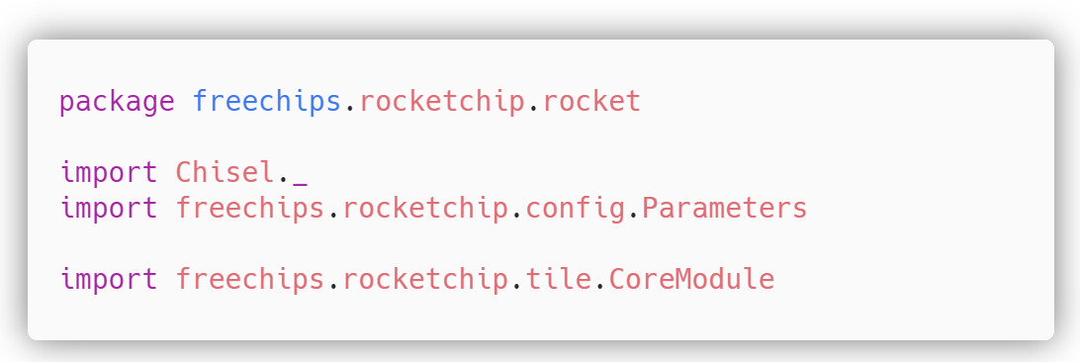
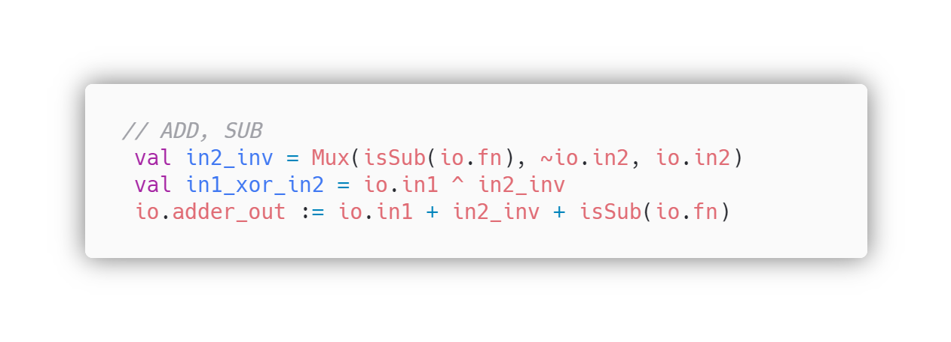
Object ALU is defined
ALU operation bits are defined in method SZ_ALU_FN
ALU operations are defined
Importing all properties of Chisel
Input/Output of class ALU are defined
Class Parameters is imported from directory config of rocket-chip
Class CoreModule is imported from directory tile of rocket-chip

Slide 21
Deep Dive into Rocket-ALU
Class ALU has three inputs and three outputs
ALU I/O | Description
dw | Data width is an input of ALU which can be 32bit or 64 bit
fn | fn (ALU operation Bits) as input, width is predefined by 4
in2 | Operand B Second input, here xLen can be changed to 32 or 64bits
in1 | Operand A First input, here xLen can be changed to 32 or 64bits
out | It is the ALU result output for logical operators, generated by the ALU
adder_out | It is the ALU result output for mathematical operators, generated by the ALU
cmp_out | ALU output indicating branch taken or not taken output whether branch condition True or False

Slide 22
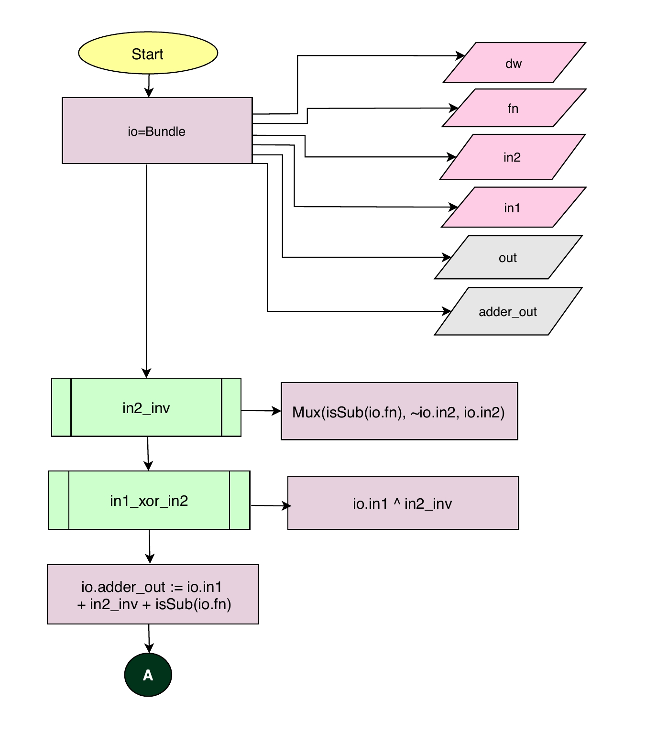
In Rocket-Core ALU, this code block performs addition and subtraction operations.
The result of the addition / subtraction operation performed by ALU is outputby adder out
Variable in2_inv is initialized with Mux function which has parameters, isSub function with parameter io.fn as selector, Not of io.in2 as input1 of Mux, and io.in2 as input2 of Mux
Variable in1_xor_in2 is initialized with io.in1 XOR’ed ( ^ ) with in2_inv.
Io.adder_out is wired to io.in1 + in2_inv + isSub of io.fn

Slide 23
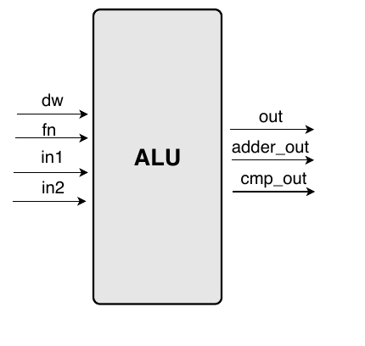
out = ALU result output for logical operators [31:0]/[63:0]
dw = datawidth [31:0]/[63:0]
fn = ALUop bit as input [3:0]
adder_out = ALU result output for mathematical operations [31:0]/[63:0]
In1 = Operand B of ALU as input [31:0]/[63:0]
In2 = Operand A of ALU as input [31:0]/[63:0]
Cmp_out = Branch result output [Bool]

Slide 24
MASS Document of Rocket-Chip

Slide 25
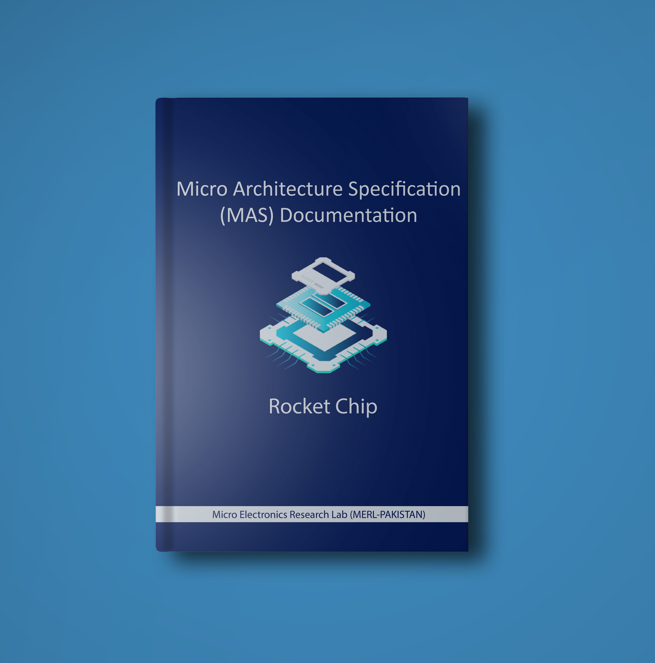
How did we do it?
Using Reverse Engineered MASS Document, which includes in depth knowledge of all Rocket-Chip modules.

Slide 26
Rocket-Core MASS Documentation Document
This MASS Document offers in-depth knowledge of Rocket-Chip SoC Rocket-Core modules.
Using Block Diagrams, Class Diagrams, Flowcharts, and describing all the keywords found in the code, description of modules is achieved.
This MASS Document is essential for those who have fundamental knowledge of Scala, Chisel and SoC hardware.
Only the The keywords used in the MASS Document are explained in detail under the Appendix-Scala & Chisel section. name is used in the MASS Document, but its meaning is stated in the keywords Appendix-Scala & Chisel.

Slide 27

Aghaaz(آغاز) SoC The Beginning

Slide 28
Specifications of Aghaaz (آغاز) SoC
RV-32 (32-bit)
I, M & C extensions
64-KB Instruction and Data Cache
CLINT
PLIC
Privileged( Machine)

Slide 29
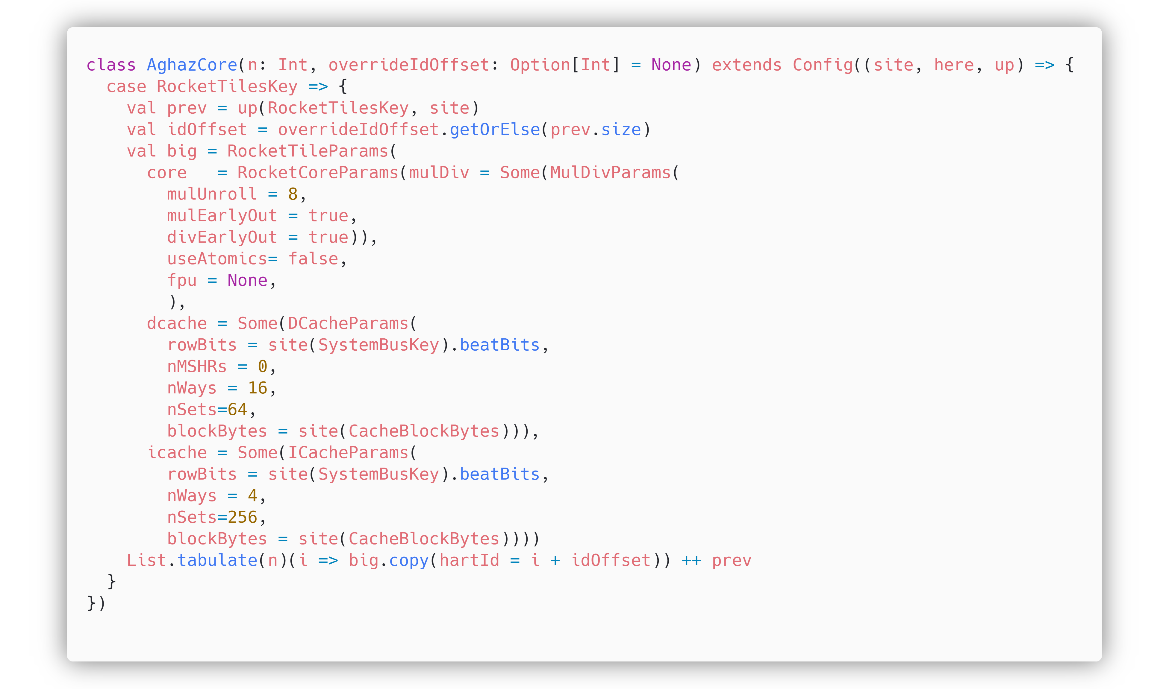
Configuring Aghaaz Core in Rocket-Chip
Path to Default Configuration Scala File
Class named AghazCore, contains the configurations for the core level functionality. This class is created in Rocket-chip/src/main/scala/subsystem/Config.scala
Rocket-Core parameters
Data Cache parameters
Instruction Cache parameters

Slide 30
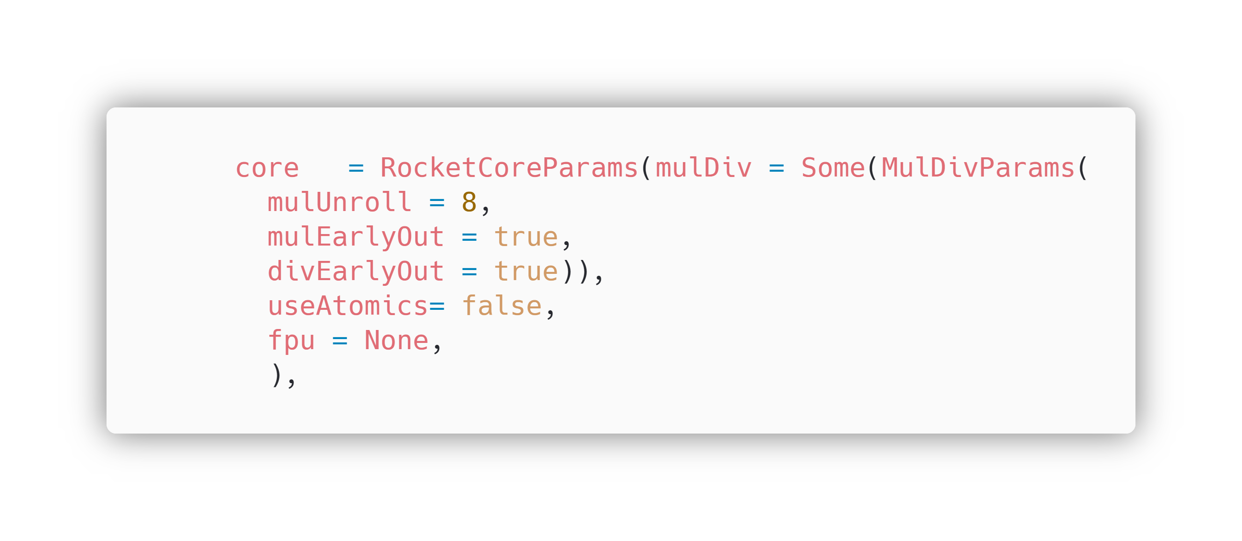
Configuring RV32IMC Core
RocketCoreParams has the parameters for configuring our Core.
We added MulDiv(Multiplier) with MulDivParmas, having default values, in the RocketCoreParams, in order to enable M extension in our Core.
The number of cycles per multiplication.
We updated fpu (Floating-Point unit) to None, to disable F and D extensions in our core.
mulEarlyOut will make the multiplier's latency data-dependent, i.e., it will take fewer cycles to multiply small numbers than large ones.
We updated the value of useAtomics to false, to disable A extension.
divEarlyOut is analogous to mulEarlyOut (smaller numbers divide more quickly than larger ones).

Slide 31
Aghaaz Core Params (Core)
In the RocketCoreParams, useCompressed is true, means C extension is enabled by default.
Extension I is the base extension and is supported by default as well.
Hence, Aghaaz core is configured to support I, M and C Extensions.
useCompressed | true | useCompressed is for C-extension, it is true by default, means our Core will have C-extension enabled implicitly.

Slide 32
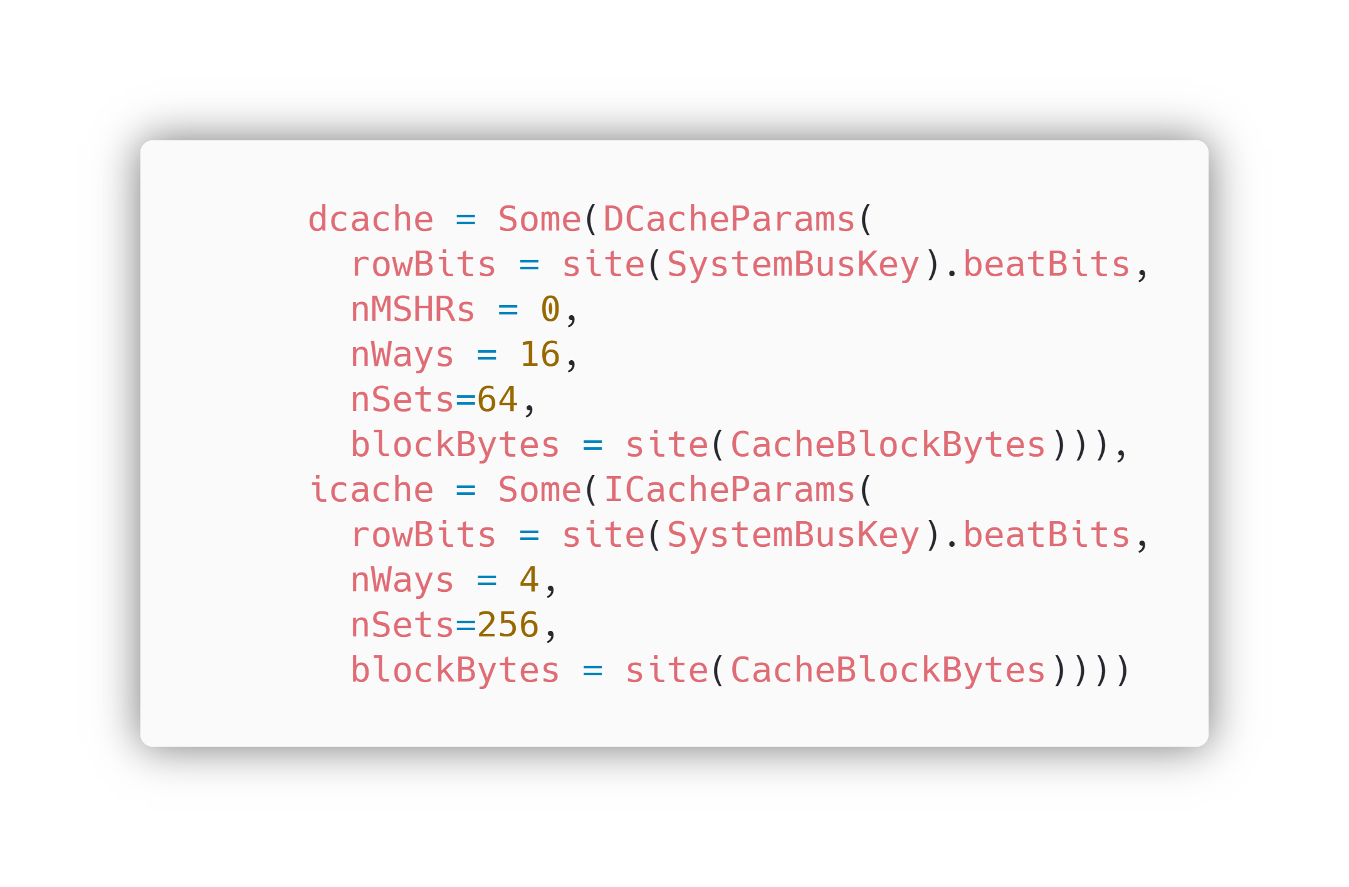
Configuring the icache and dcache in Aghaaz Core
Dcache has DCacheParams, which set the parameters for Data Cache.
Similarly, ICache has ICacheParams, which are parameters for the Instruction Cache configuration.

Slide 33
Data Cache Parameters
Parameters | Value | Description
nMSHRs | 0 | There are 0 MSHRs (Miss Status Handling Registers) in Instruction Cache
nWays | 16 | There are 16 Ways of Cache in DCache
nSets | 64 | There are 64 Sets of Cache in DCache
blockBytes | 64 (evaluated) | There are 64 blockBytes in DCache
Size of DCache is calculated by: nWays x nSets x blockBytes (16 x 64 x 64 == 64KB)
Instruction Cache Parameters
Parameters | Value | Description
nWays | 4 | There are 4 Ways of Cache in ICache
nSets | 256 | There are 256 Sets of Cache in ICache
blockBytes | 64 (evaluated) | There are 64 blockBytes in ICache
Size of ICache is calculated by: nWays x nSets x blockBytes (4 x 256 x 64 == 64KB)

Slide 34
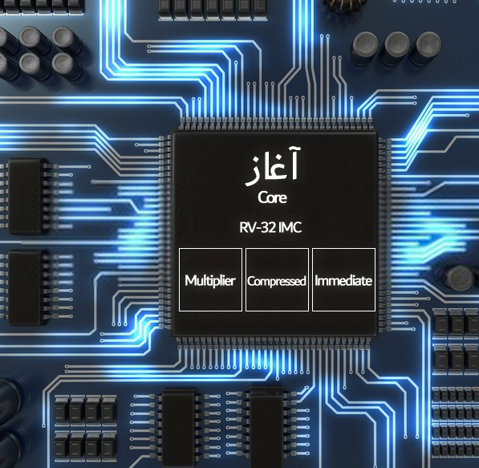
Blocks of Core
Aghaaz Core provides extensions for I, M and C with 32bit compatibility.

Slide 35
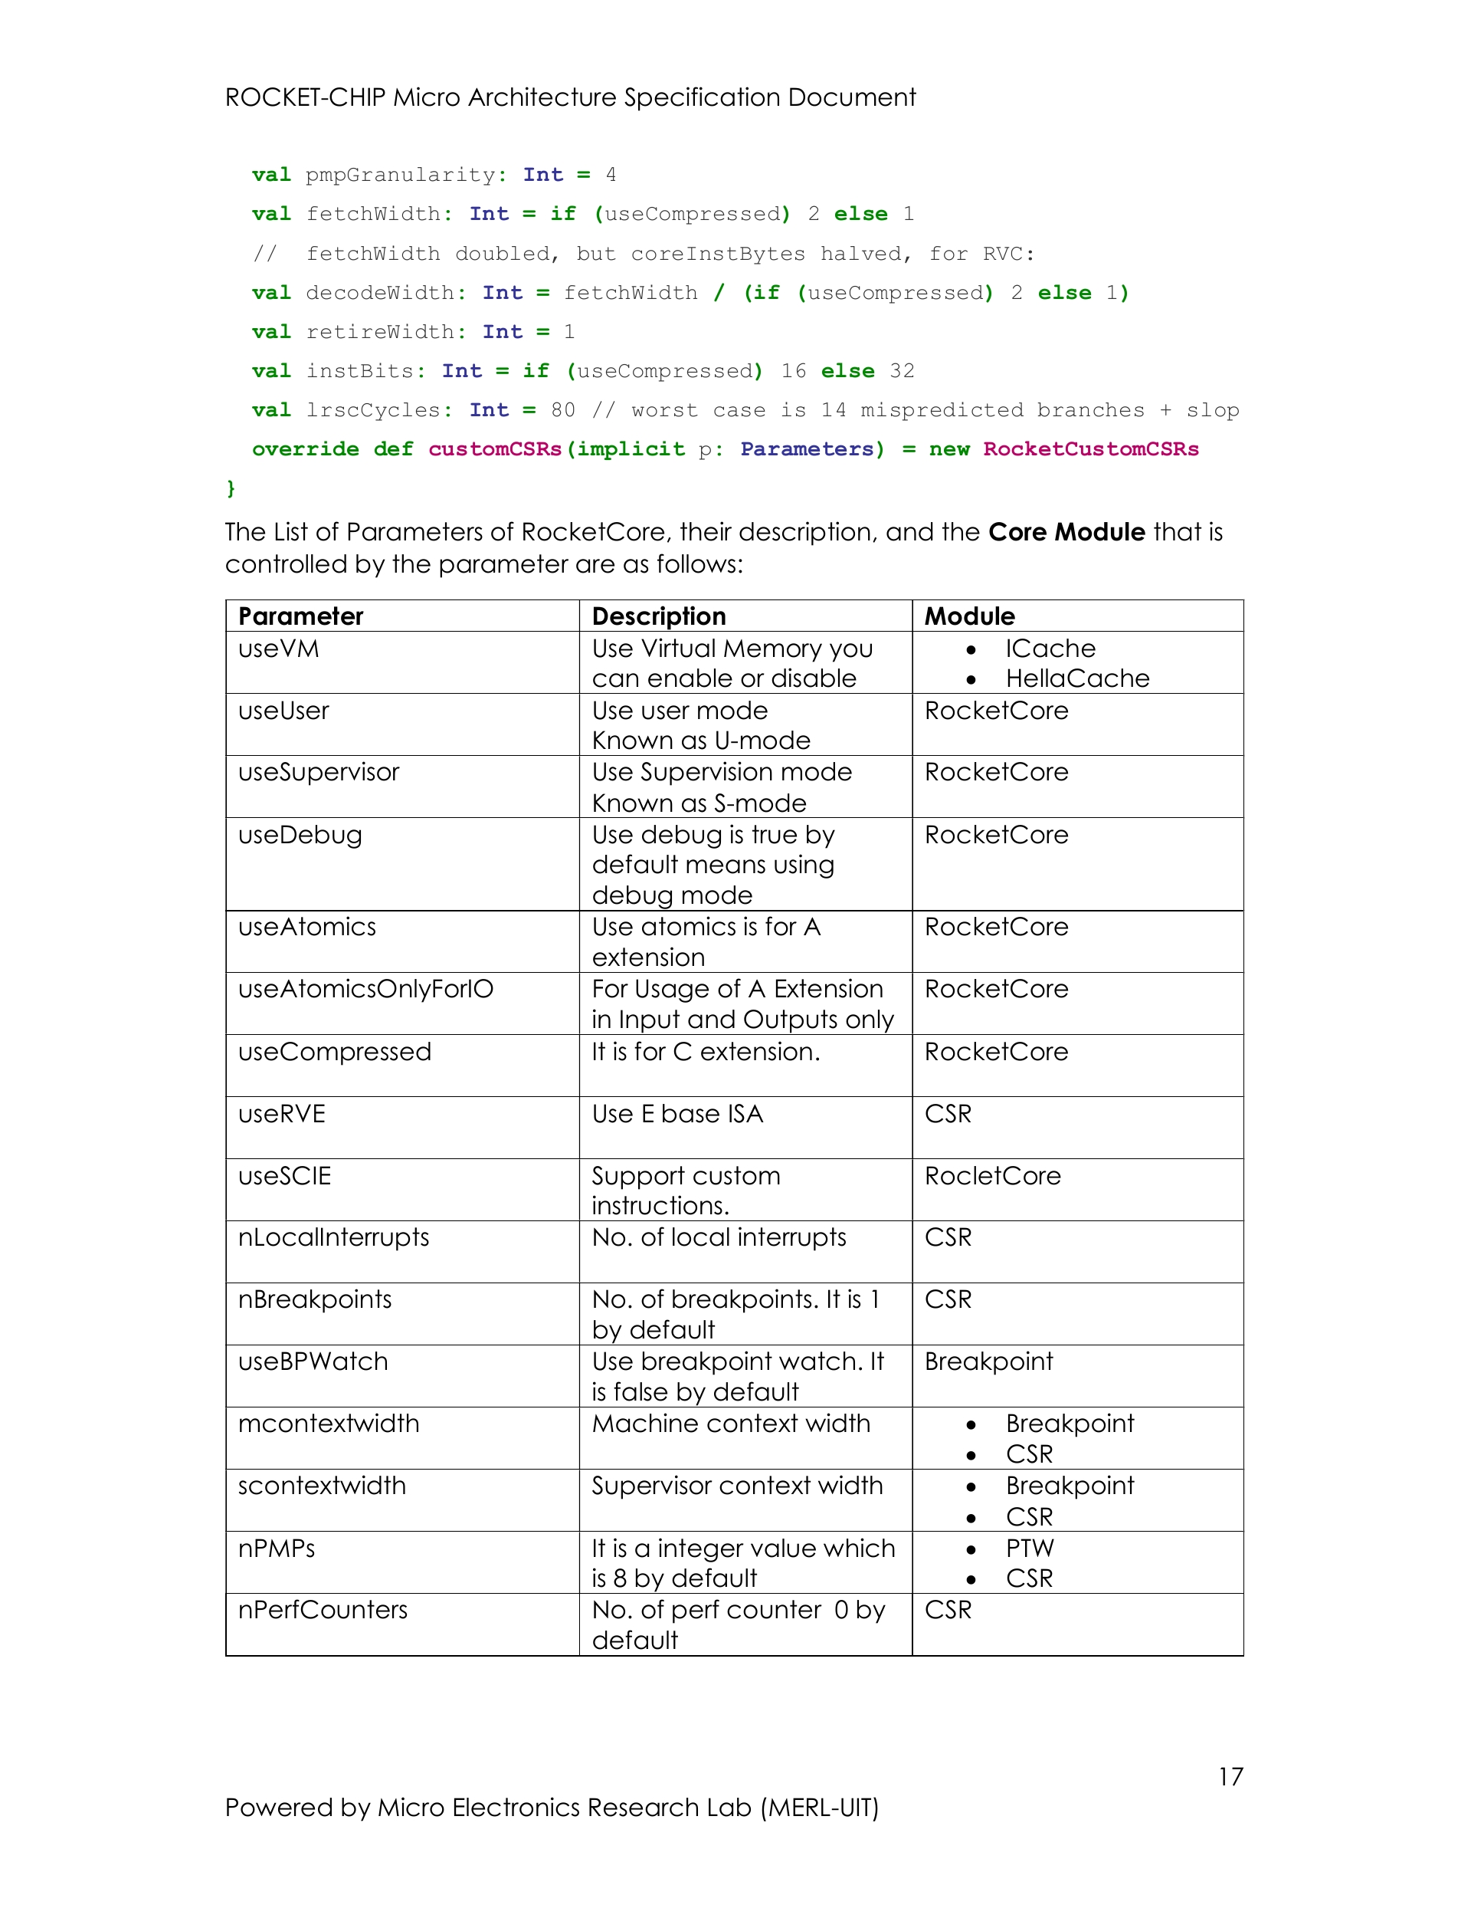
How did we know, which parameter is doing what?
The MASS Document describes the parameters, their description and the modules that are managed by that parameter.

Slide 36
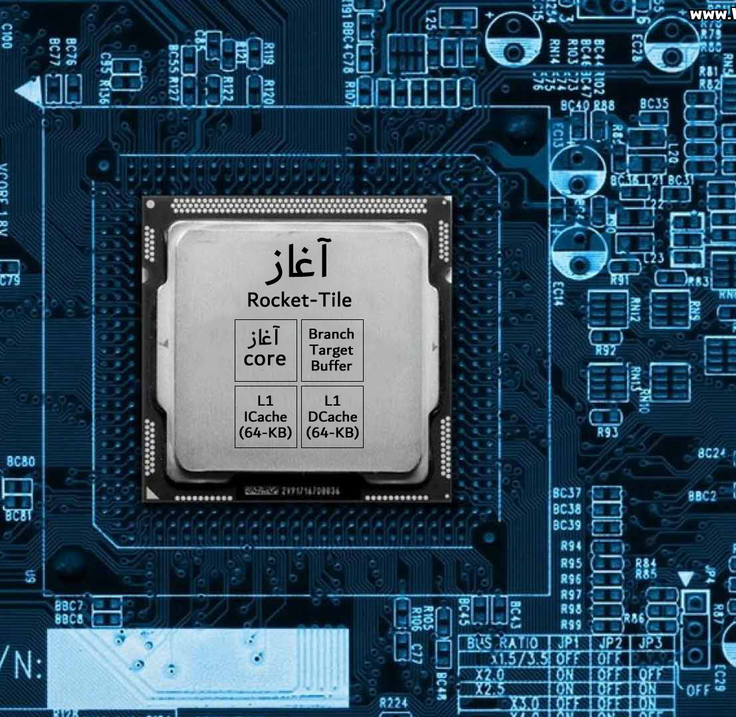
Blocks of Tile
Rocket-Tile of Aghaaz SoC contains Aghaaz Core, Branch Target Buffer, L1 Icache & DCache of 64-KB.

Slide 37
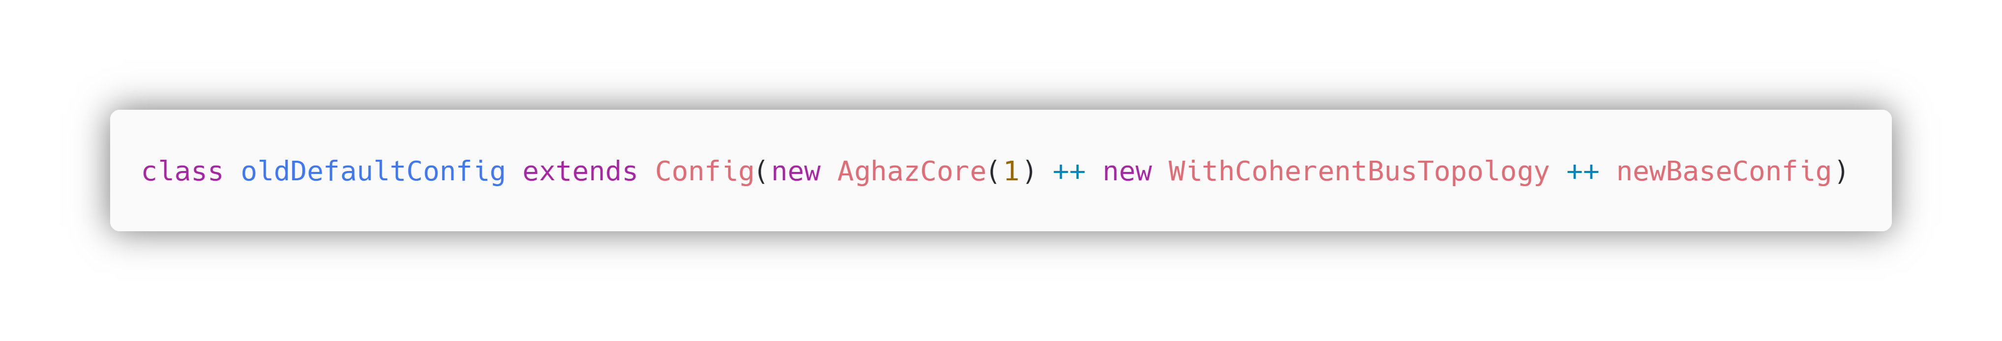
Initializing Aghaaz Core to Default Configuration
Path to Default Configuration Scala File
Default Configuration is created in Rocket-chip/src/main/scala/system/Config.scala
The class called oldDefaultConfig is inherited by the class Config.
The Class Config (Parent Class) includes the key configurations, from which all configurations must be inherited.
The AghazCore object is generated as a parameter with ’1’ indicating that there is only one(1) core in our AghazCore.
The AghazCore object is further added to the WithCoherentBusTopology object, which includes configurations for the Bus level.
These objects are further added by the newBaseConfig object, which contains the base configurations.

Slide 38
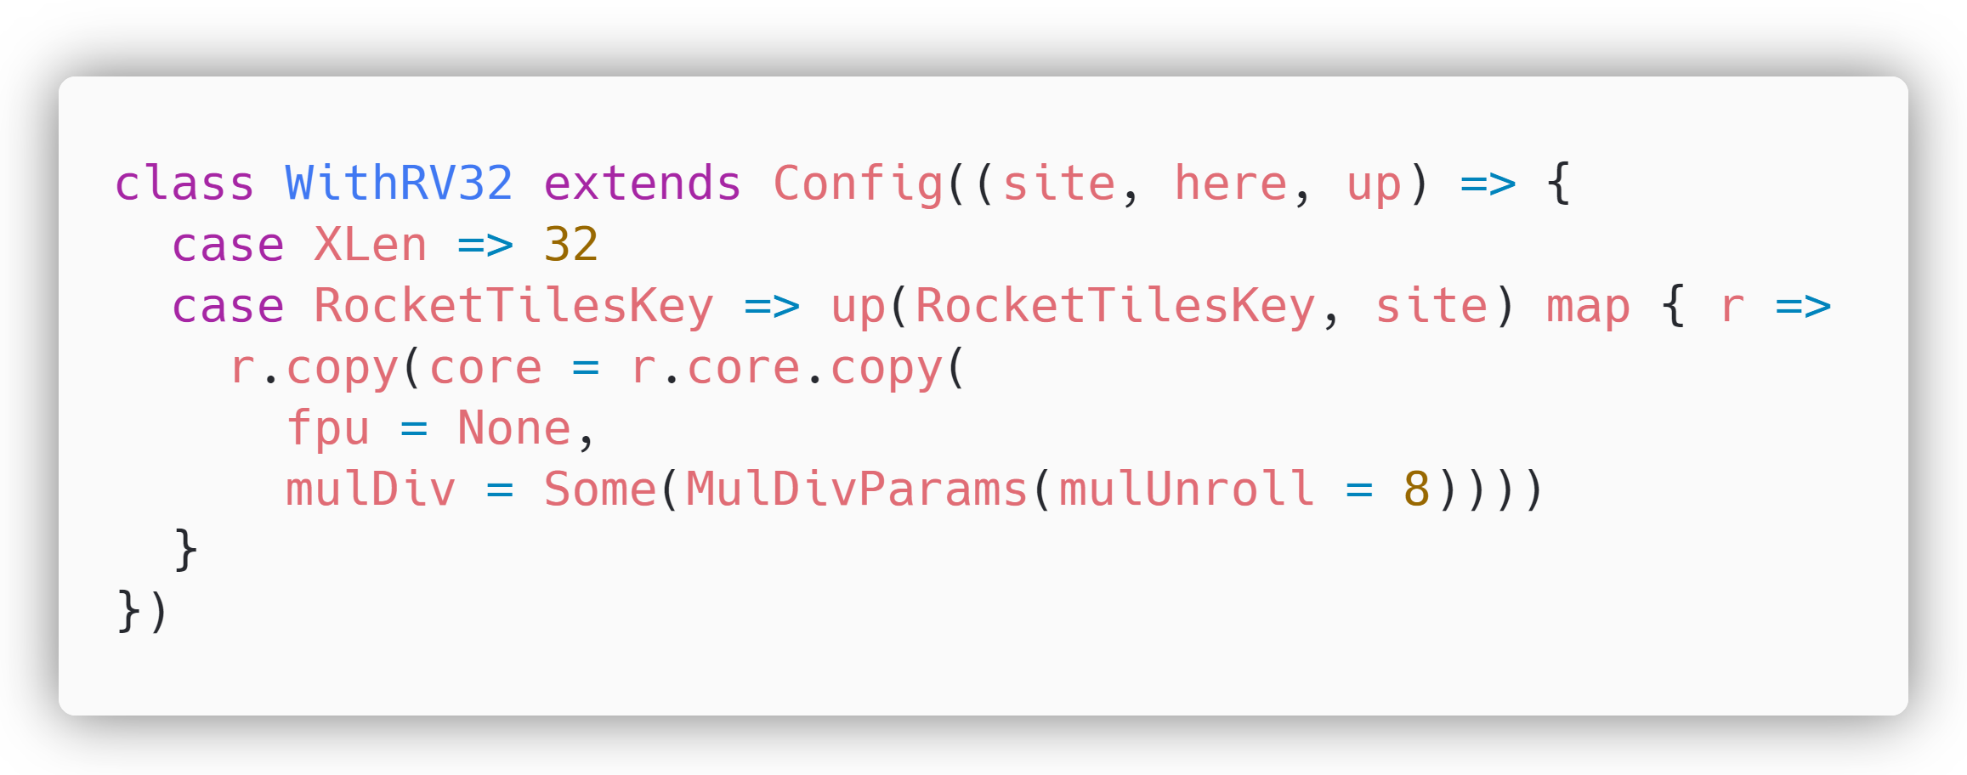
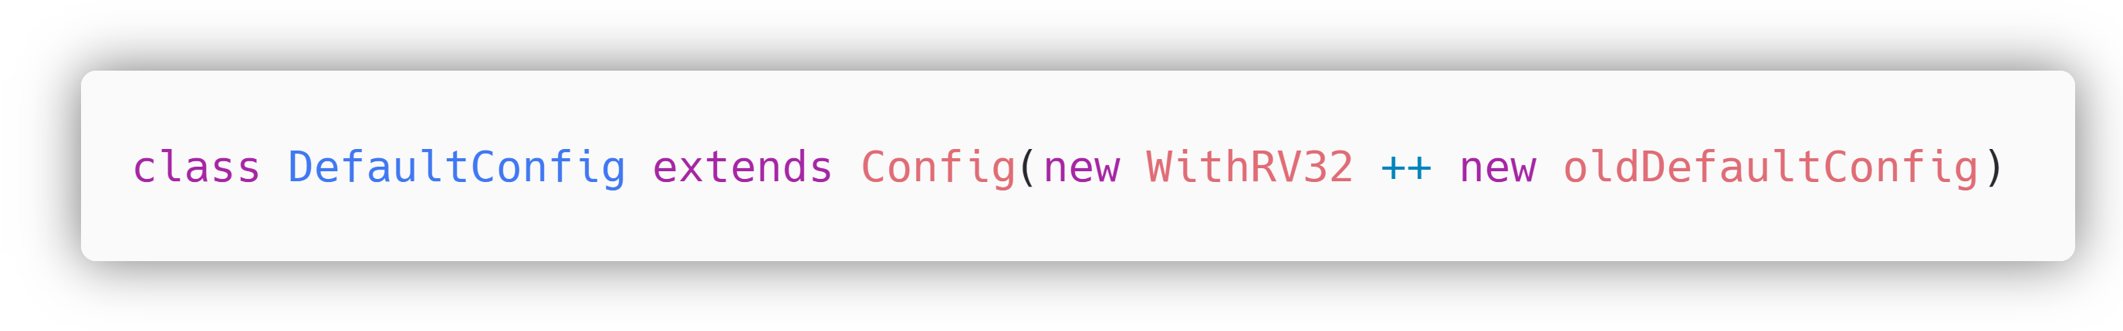
Customizing AghazCore to 32-bit Configuration

Slide 39
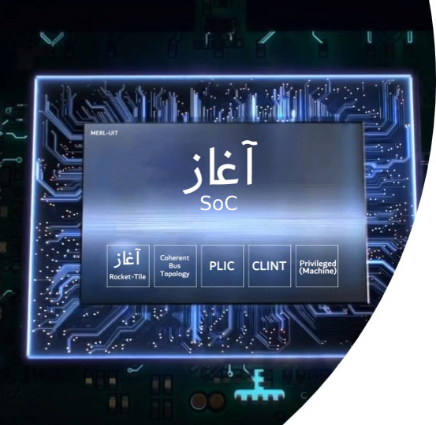
Blocks of SoC

Slide 40
At this point our Aghaaz SoC is successfully configured and ready to be built

Slide 41
Configuring an SoC to your Requirements in a quick process by means of this MASS Document

Slide 42
Acknowledgements This Document was made possible with the counselling, guidance and support of Dr.Roomi Naqvi, Dr Ali Ahmed Ansari, and Farhan Ahmed Karim. Without their encouragement and guidance, this could not be possible. This Document was created under the Lead of Uzair Khan, along with the team of collaborators/ interns under him that gave their level best under the supervision of such experienced mentors.
Team Members
Waleed Waseem
Shahzaib Kashif
Talha Ahmed
Mohsin Raza
Muhammad Shahzaib
Syeda Fizza Jaffery
Almas Ibrahim
Ubab Nadeem

Slide 43
December 8-10 | Virtual Event
Thank you for joining us.
Contribute to the RISC-V conversation on social!
#RISCVSUMMIT @risc_v

Slide 44
https://docs.boom-core.org/en/latest/sections/intro-overview/rocket-chip.html

